Slide 1

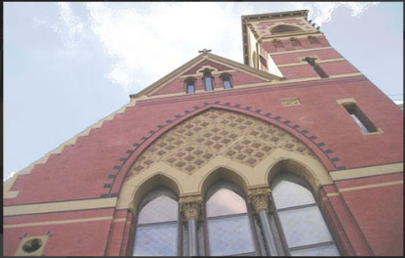
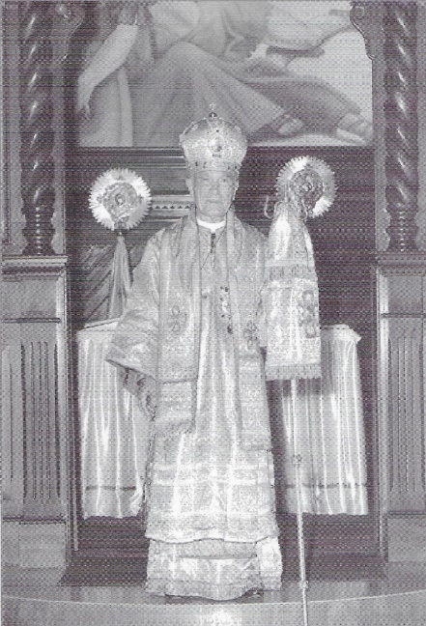
Celebrate Albanian Independence Day
by Helping to Preserve Fan Noli’s Church
When Fan Noli celebrated the first Divine Liturgy in the
Albanian language “our eyes were filled with tears.”
~ Constantine “Nini” Demo
Fan Noli’s Church is seeking the support of
the entire Albanian community for its major
restoration and renovation project.
Please consider a generous gift to preserve our beloved Fan Noli’s Church for future generations.
Kindly Make Your Donation* Payable to:
Albanian Orthodox Cathedral of St. George
523 East Broadway
South Boston, MA 02127–4415
Or, if you prefer, you can donate online through
the Cathedral donation website link at:
https://tithe.ly/give_new/www/#/tithely/give-one-time/6085471?widget=1&giving_to=General%20Fund
For more information, please contact the Chancery Office at (617) 268–1275 or email at saintgeorgecathedral.adm@gmail.com
*St. George Cathedral is a 501(c)(3) charitable organization, and all donations are fully tax-deductible, in accordance with the law. You may also make a Qualified Charitable Donation (QCD) from your Individual Retirement Account (IRA). Please consult your tax specialist for further information.
If you wish to earmark your donation for any specific aspect(s) of the renovations, please be sure to specify your selection(s) at the time of your donation.

